Slide 1
Artificial Neural Network
(BPNN-Example )

Slide 2
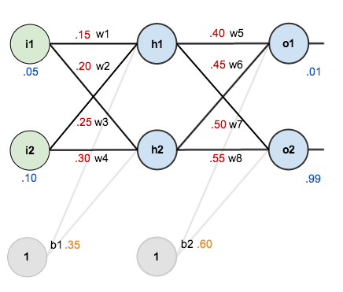
Example

Slide 3
The Forward Pass
The goal of backpropagation is to optimize the weights so that the neural network can learn how to correctly map arbitrary inputs to outputs.
we’re going to work with a single training set: given inputs 0.05 and 0.10, we want the neural network to output 0.01 and 0.99.
We figure out the total net input to each hidden layer neuron, squash the total net input using an activation function (here we use the logistic function), then repeat the process with the output layer neurons.

Slide 4
The Forward Pass
Here’s how we calculate the total net input for
We then squash it using the logistic function to get the output o
Carrying out the same process for

Slide 5
Example
We repeat this process for the output layer neurons, using the output from the hidden layer neurons as inputs. Here’s the output for
And carrying out the same process for we get:

Slide 6
Calculating the Total Error
We can now calculate the error for each output neuron using the squared error function and sum them to get the total error:
For example, the target output for is 0.01 but the neural network output 0.75136507, therefore its error is:
Repeating this process for (remembering that the target is 0.99) we get:
The total error for the neural network is the sum of these errors:

Slide 7

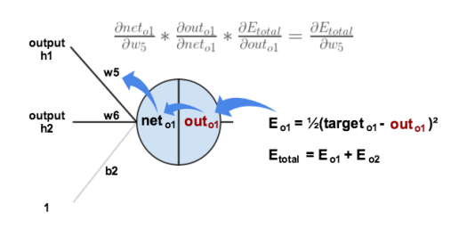
The Backwards Pass: Output Layer
Our goal with backpropagation is to update each of the weights in the network so that they cause the actual output to be closer the target output, thereby minimizing the error for each output neuron and the network as a whole.
Output Layer
Consider . We want to know how much a change in affects the total error, aka

Slide 8
Cont…
We need to figure out each piece in this equation.
First, how much does the total error change with respect to the output?

Slide 9
Cont…
Next, how much does the output of change with respect to its total net input?
The partial derivative of the logistic function is the output multiplied by 1 minus the output:
Finally, how much does the total net input of change with respect to ?
Putting it all together:

Slide 10
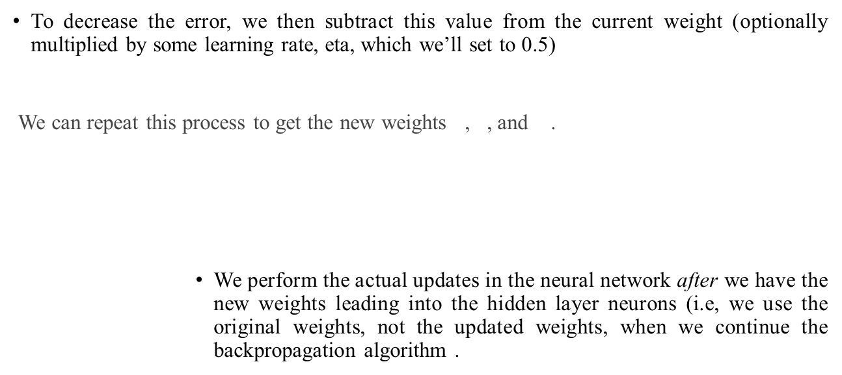
Cont…

Slide 11
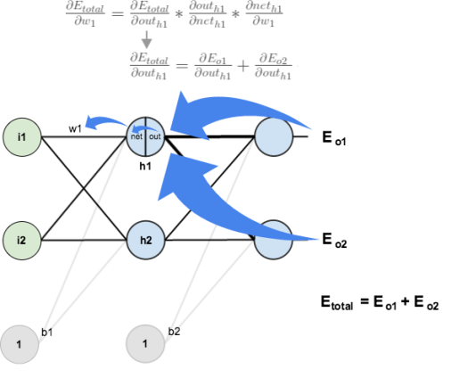
Hidden Layer Pass
Next, we’ll continue the backwards pass by calculating new values for , , , and .
We’re going to use a similar process as we did for the output layer, but slightly different to account for the fact that the output of each hidden layer neuron contributes to the output (and therefore error) of multiple output neurons.

Slide 12
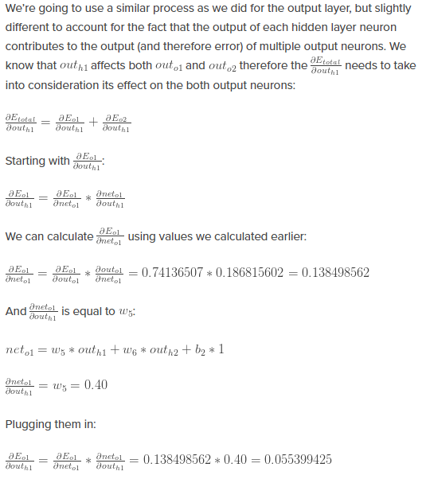

Slide 13
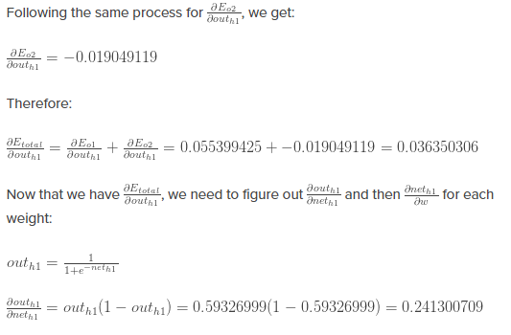

Slide 14
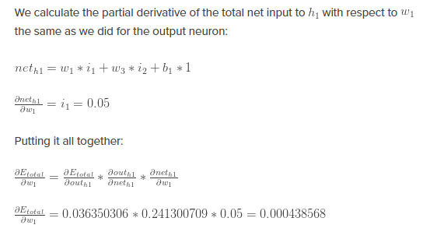

Slide 15
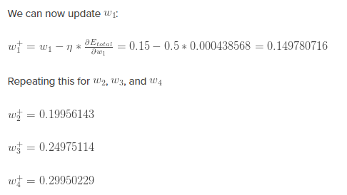
Finally, we’ve updated all of our weights! When we fed forward the 0.05 and 0.1 inputs originally, the error on the network was 0.298371109.
After this first round of backpropagation, the total error is now down to 0.291027924.
It might not seem like much, but after repeating this process 10,000 times, for example, the error plummets to 0.0000351085.
At this point, when we feed forward 0.05 and 0.1, the two outputs neurons generate 0.015912196 (vs 0.01 target) and 0.984065734 (vs 0.99 target).

Slide 16
Thank
You

